Slide 1
Week 6
Doing a Join in Tuple Relational Calculus

Slide 2
Student Objectives
Upon completion of this video, you should be able to:
List a set of tables and a query, write the tuple relational calculus statement that will answer the query
Determine when and when not to use the existential quantifier symbol ∃
Given a set of tables and a relation calculus expression, list the tuples that would be returned.

Slide 3
We will be using the following tables for our discussion and examples:
Employee
FName | Minit | Lname | SSN | BDate | Address | Sex | Salary | SuperSSN* | DNO*
Department
DName | DNumber | MGRSSN* | MgrStartDate
Works_On
DepartmentLocation
ESSN* | PNO* | Hours
Dnumber* | Dlocation
Project
PName | PNumber | Plocation | Dnum*
Dependent
ESSN* | DependentName | Sex | BDate | Relationship

Slide 4
Also we need two more symbols called quantifiers: they are the universal quantifier → ∀ and the existential qualifier → ∃
With the existential quantifier, a formula: (∃t)(F) is TRUE if the formula F evaluates to TRUE for some (at least one) tuple.
If you are NOT displaying a tuples attribute in your answer, but you need that tuple from another table to do the join, then you MUST use (∃t)(F)
With the universal quantifier, a formula: (∀t)(F) is TRUE only if the formula F evaluates to TRUE for every tuple.

Slide 5
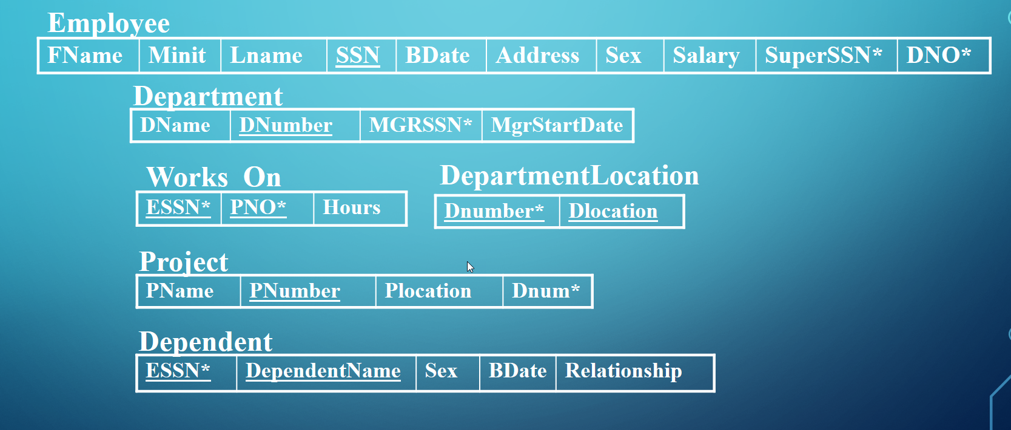
Tuple Calculus Examples (joining tables) :
Retrieve the name and address of all employees who work for the 'Research' Department
{t.Fname, t.Lname, t.Address | EMPLOYEE(t) and ((∃d) (DEPARTMENT(d) and d.Dname = 'Research' and d.Dnumber = t.DNO))}
For every project located in 'London', list the project number, the controlling department number, and the department manager's last name.
{p.PNumber, p.Dnum, e.Lname | PROJECT(p) and EMPLOYEE(e) and p.PLocation = 'London' and ((∃ d)(DEPARTMENT(d) and d.Dnumber = p.Dnum and d.Mgrssn = e.ssn))}

Slide 6
Find the name of employees who have no dependents:
{e.Fname, e.lname | EMPLOYEE(e) and (NOT (∃d) (DEPENDENT(d) and e.SSN = d.ESSN))}
OR
{e.Fname, e.lname | EMPLOYEE(e) and ((∀d) (NOT DEPENDENT(d)) or NOT(e.SSN = d.ESSN))

Slide 7
QUESTION: Write the tuple relation calculus to find any employee last name who work on projects. Also list the number of hours they worked on the project and the project name:
{e.Lname, w.Hours, p.Pname | EMPLOYEE(e) and WORKSON(w) and PROJECT(p) and p.PNumber=w.PNO and w.ESSN=e.SSN}

Slide 8
QUESTION: Write the tuple relation calculus to find any employee lastname and project name of employees who work on projects:
{e.Lname, p.Pname | EMPLOYEE(e) and PROJECT(p) and ((∃w) (WORKSON(w) and p.PNumber=w.PNO and w.ESSN=e.SSN))}

Slide 9
AA
BB
A | B | C
Pig | 22 | Pink
Cat | 22 | Green
Cat | 55 | Blue
A | B | C | D
Pig | 22 | Blue | 14
Cat | 22 | Green | 33
Cat | 22 | Blue | 22
A | B | C
Cat | 22 | Green
Cat | 55 | Blue
{w| AA(w) and w.A = “Cat” }
C
Blue
{w.C | BB(w) and w.B > =w.D }
{t.C, w.D | AA(t) and BB(w) and w.C = t.C }
t.C | w.D
Green | 33
Blue | 14
Blue | 22
{t.A, t.C | AA(t) and ((∃w) BB(w) and w.C= t.C and w.D >=20 }
A | C
Cat | Green
Cat | Blue

